Slide 1
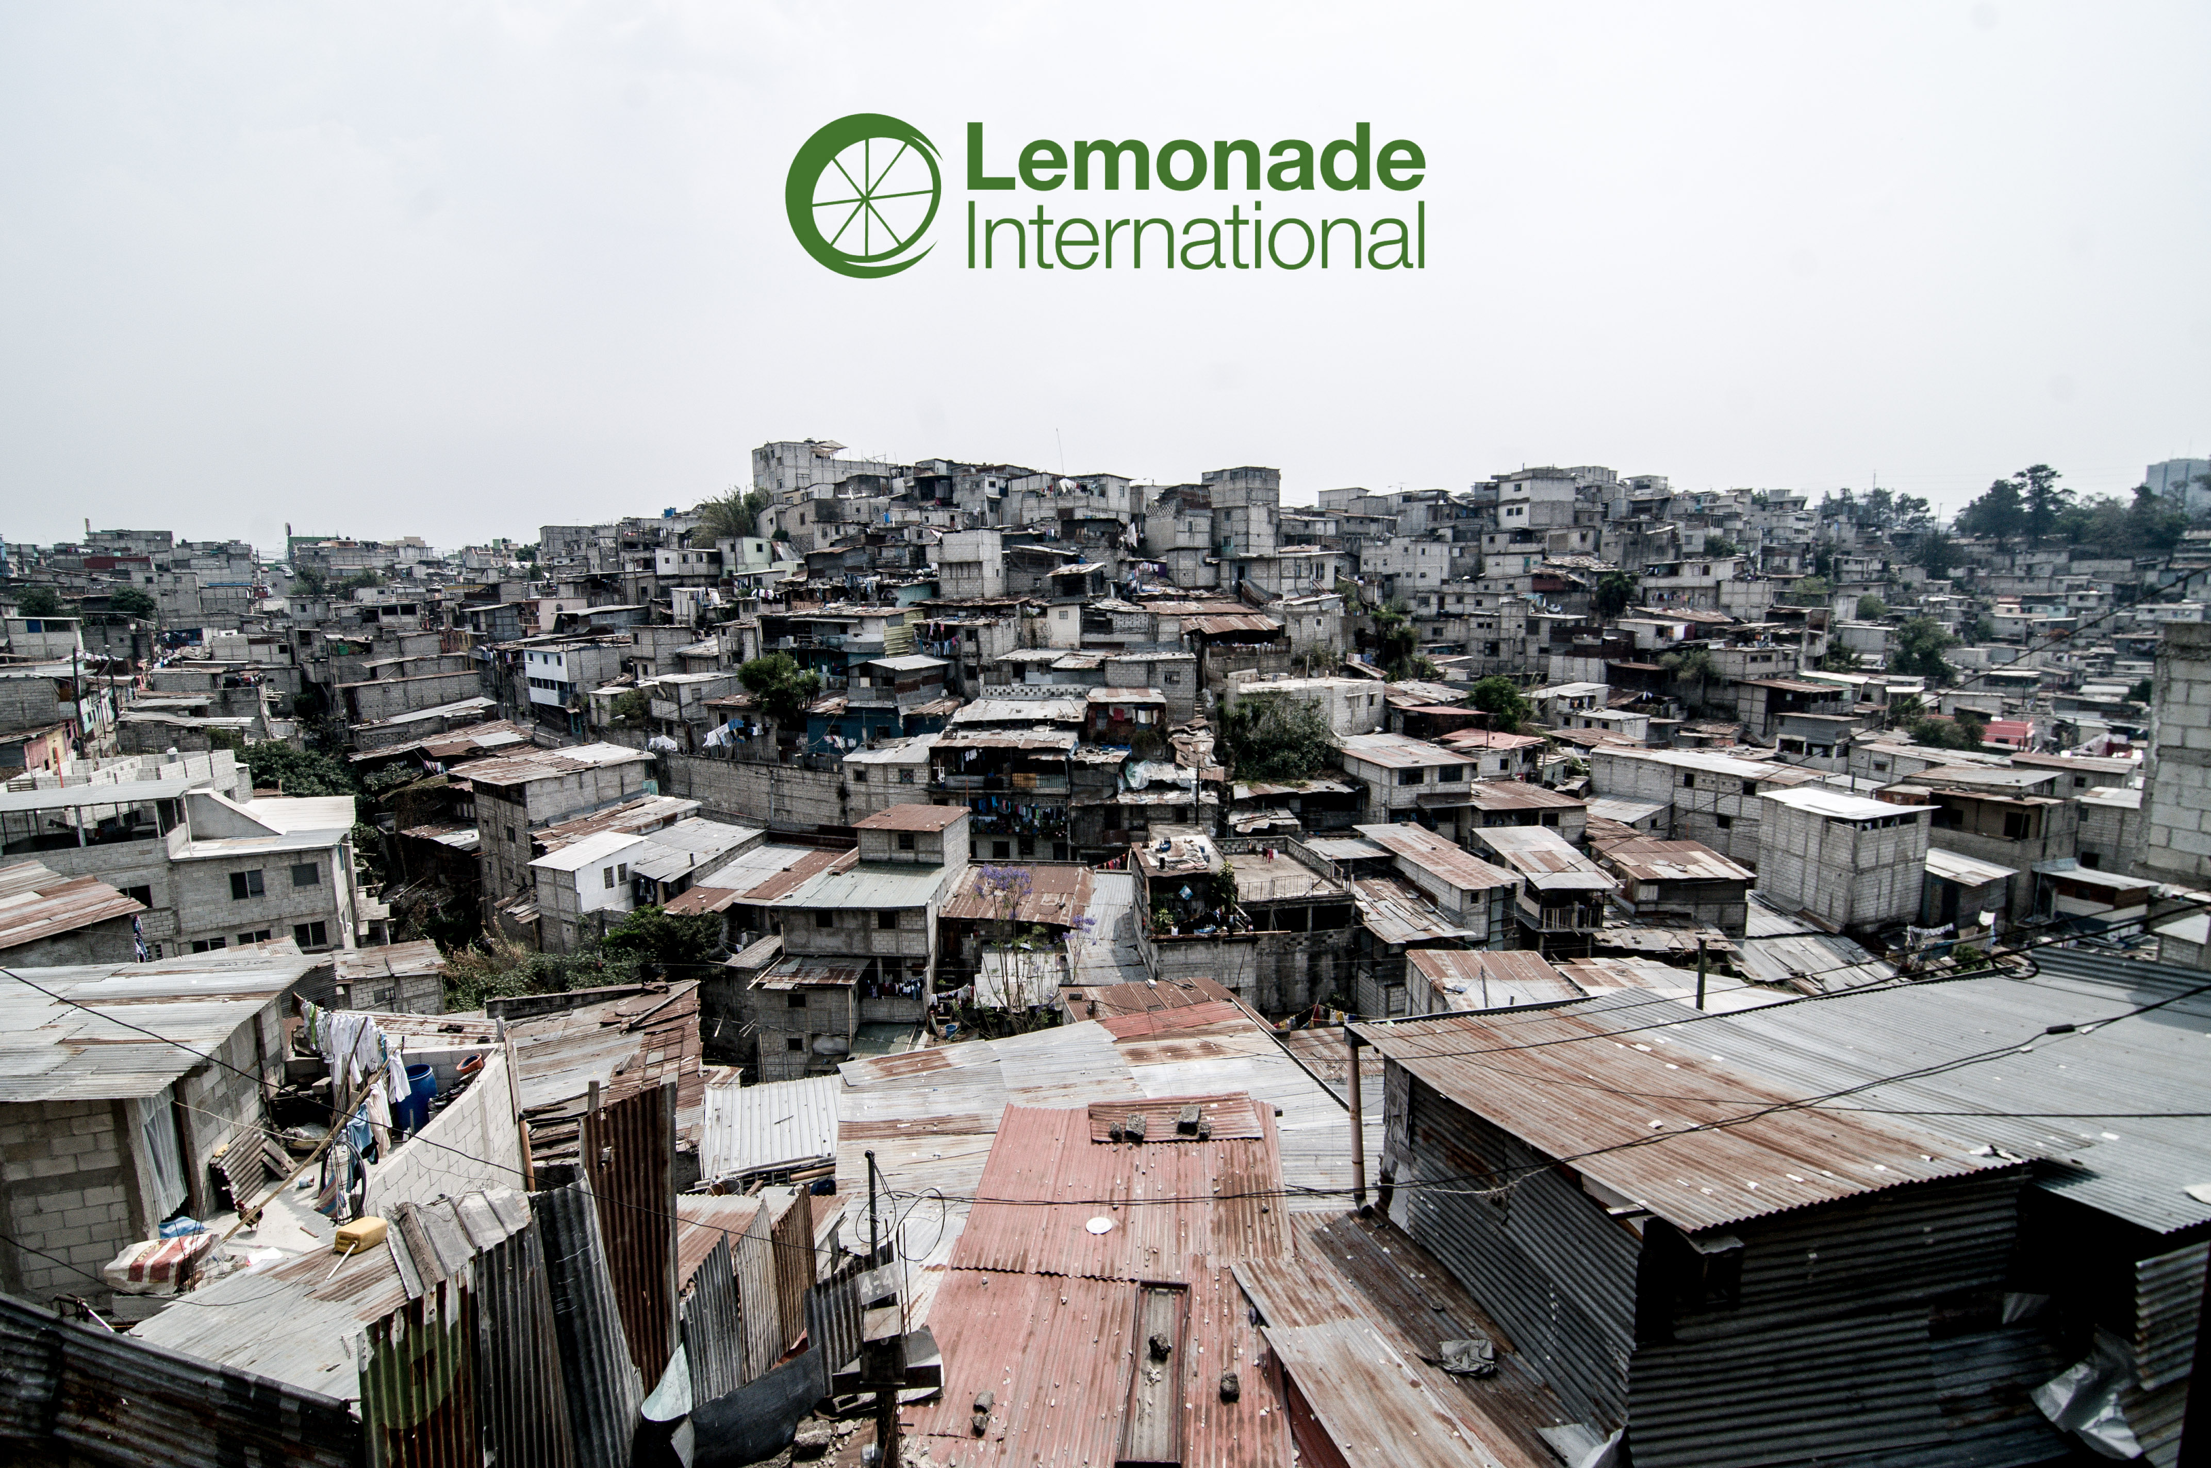

Slide 2
What We Do
Lemonade International is committed to the mission of our Guatemalan partner, Vidas Plenas, as they work in gang prevention, rescue outreach, and community care in La Limonada. Our shared desire is for those most in need to experience holistic transformation and to live full lives through a relationship with Jesus.
PREVENTION
Gang prevention through education and intervention. The Academies serve children ages 4 to 15 and the Scholars program enables children to continue their education past 6th grade.
RESCUE
Outreach to those already drawn into the darkness. The Rescue program reaches youth-at-risk who have already been tempted by gang life.
CARE
Comprehensive care through Home Visits and the Community Relief program, providing relief for the urgent and unexpected needs of the most vulnerable in La Limonada.

Slide 3
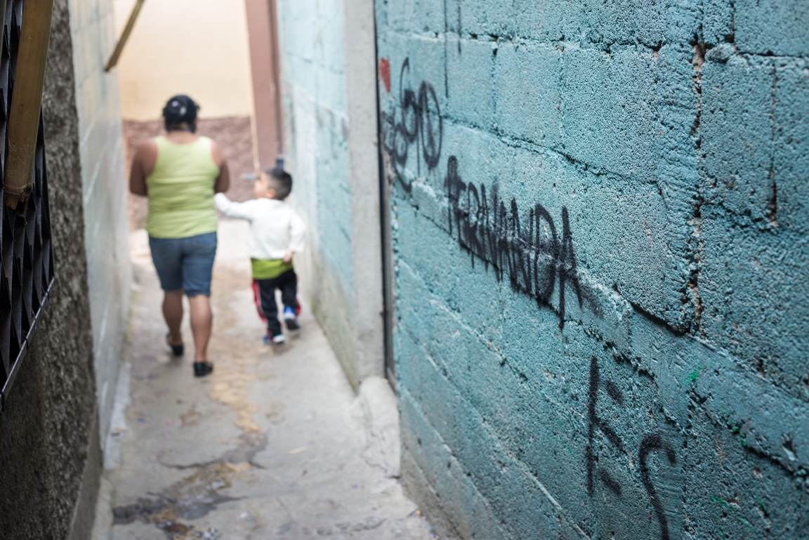
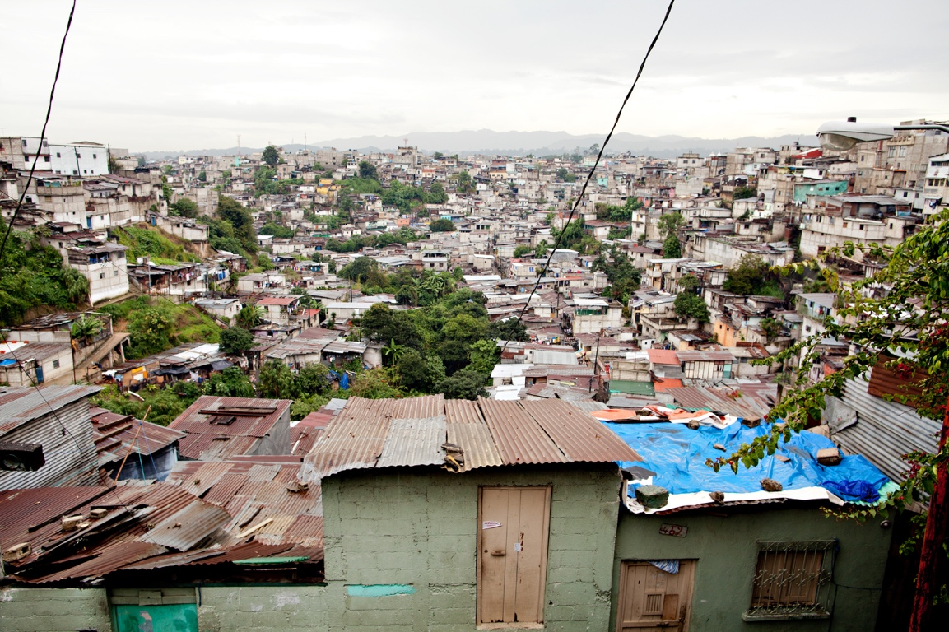
Why La Limonada?
An estimated 60,000 to 100,000 people live in an urban slum community in the heart of Guatemala City. Built into a ravine a mile long and half a mile wide, there are ten neighborhoods, each one protected by its own gang.
La Limonada, or “The Lemonade,” is notorious for violence, theft, drugs, lack of access to social services, sexual exploitation, and murder.
Deeply marginalized and dehumanized by the rest of the city, many spiral into destructive, desperate, and fatalistic lives. We are called to enter into this story as partners and friends.
We are in La Limonada because God is there.

Slide 4
The Rescue Bridge Model
The reality of poverty and profound marginalization hits the children around age 7.
Targeting the children from 3 to 7 years old and walking with them through their most vulnerable years, the Vidas Plenas team offers them the life-changing message of the Gospel and a bridge over the darkness that awaits them.
The ultimate goal is to see the children equipped and transformed, ready to lead godly families, and acting as the future leaders of their community, while leading full lives in Jesus.

Slide 5
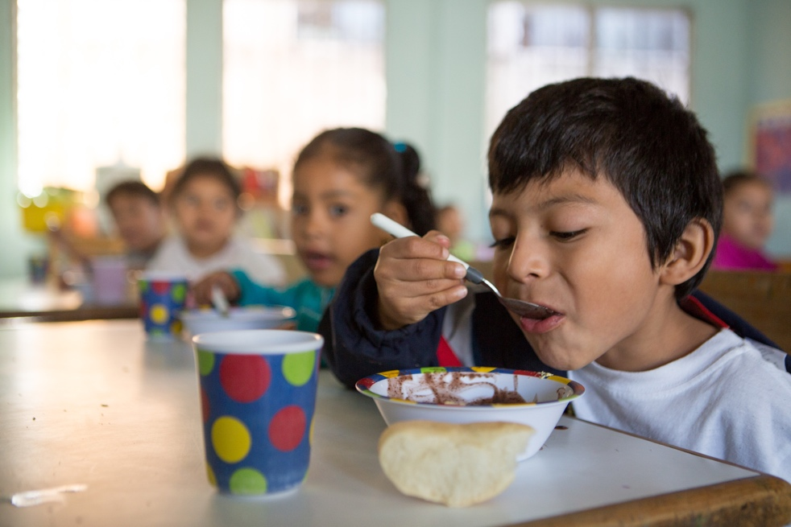
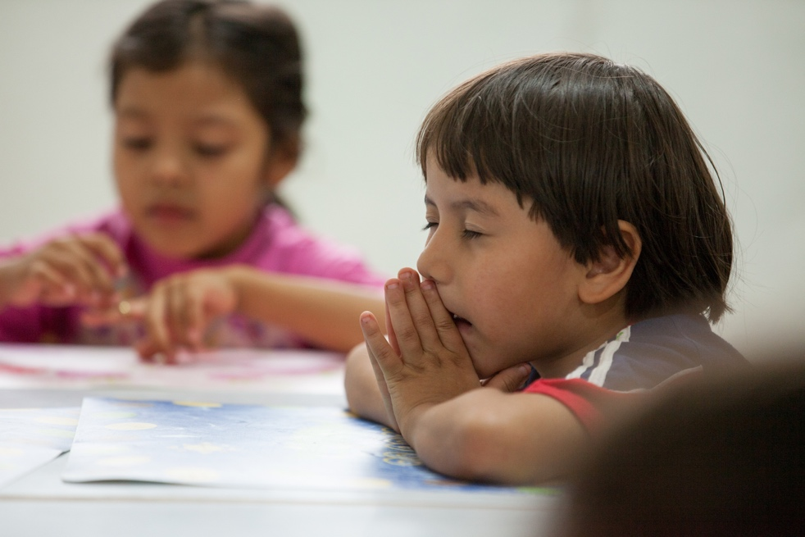
Holistic Impact

Slide 8
Make Holistic Impact Possible!

